Slide 1
A DATABASE SYSTEM FOR TRACKING WATER CONTAMINANTS AND RECOMMENDING FILTERS
Fall 2020
Trevor Seidel, Prosper Kosi Anyidoho, Akshat Katoch, Dionne Williams
Datasharks

Slide 2
Business Case
Idea: Identify communities with high water contaminants to implement an efficient water filtration system.
Problem : Water contaminants in drinking water.
Solution: Providing a service (product recommendations) to improve quality of life to at-risk residents by replacing outdated water filters.
Approach : Compile information in a database to identify communities with high level water contaminants in order to recommend products to reduce or eliminate hazardous drinking water.

Slide 3
User Stories
Some key examples:
As a homeowner, I want to search water quality in my area so that I can know whether my home has safe drinking water.
As a healthcare researcher, I want to look up a list of communities that have dangerous levels of contaminants.
As a business owner I would like to recommend products that are applicable to the user’s needs based on contaminant levels in the user's area.
As a customer I want to be able to write reviews on product satisfactory

Slide 4
Data Generation and Insertion
Python scripts were used to randomly generate data and stored in csv files. The pandas library was very useful in this situation due to its ability to store the data in a dataframe and write it to the csv files.
Built web scraper in python to obtain data on water filter names, prices, ratings and reviews.
Process to create data sequentially would have taken many hours, therefore we parallelized the code and ran on Caviness node.
Geographic data from GIS (eg. zip codes, counties)

Slide 5
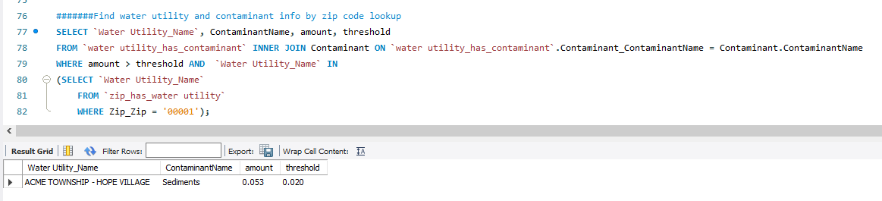
Queries for our Stories

Slide 6
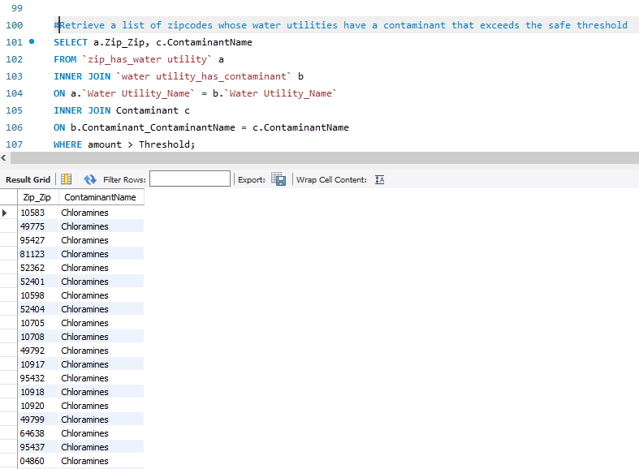

Slide 7
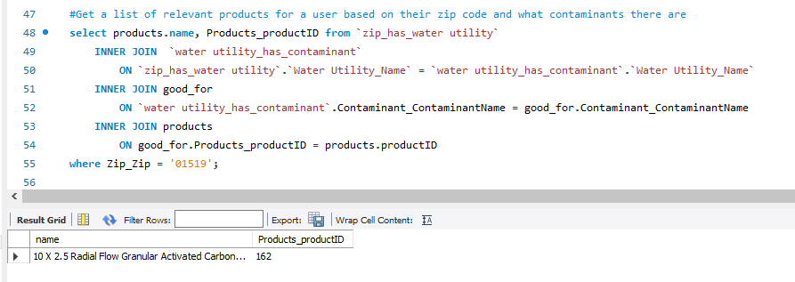

Slide 8
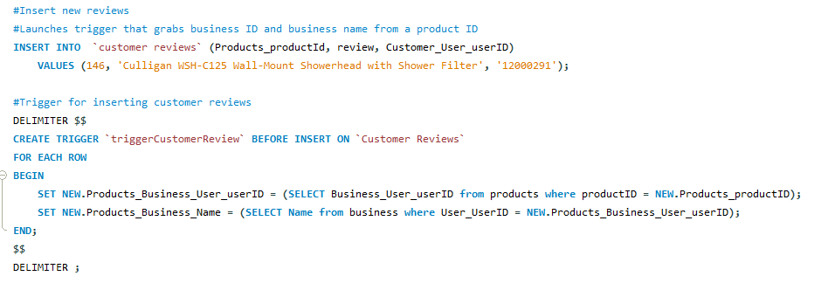

Slide 9
Query Optimization
Appropriate filter indexes for efficient retrieval of information. Queries that involved retrieval of few tuples should have good seek index to avoid index scan
The default InnoDB transactional storage engine helped with performance.
We discovered that adding an index didn’t initially improve our query-- we also had to increase our innodb_buffer_pool_size (8M to 1G)

Slide 10
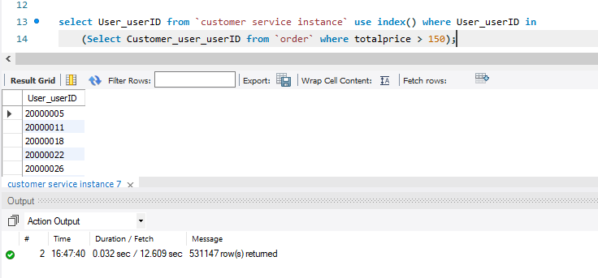
Using Indexes to Optimize

Slide 11
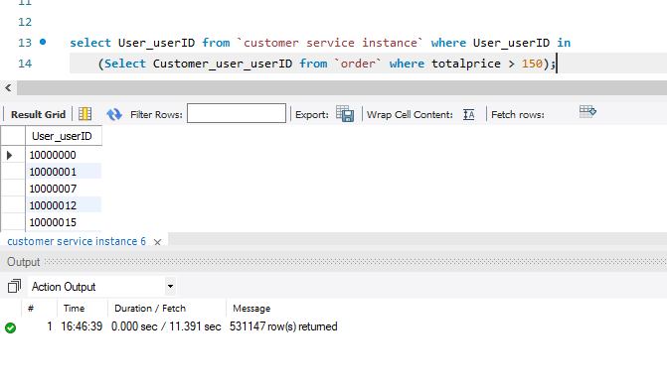
Slightly improved with an index on userID

